Slide 1
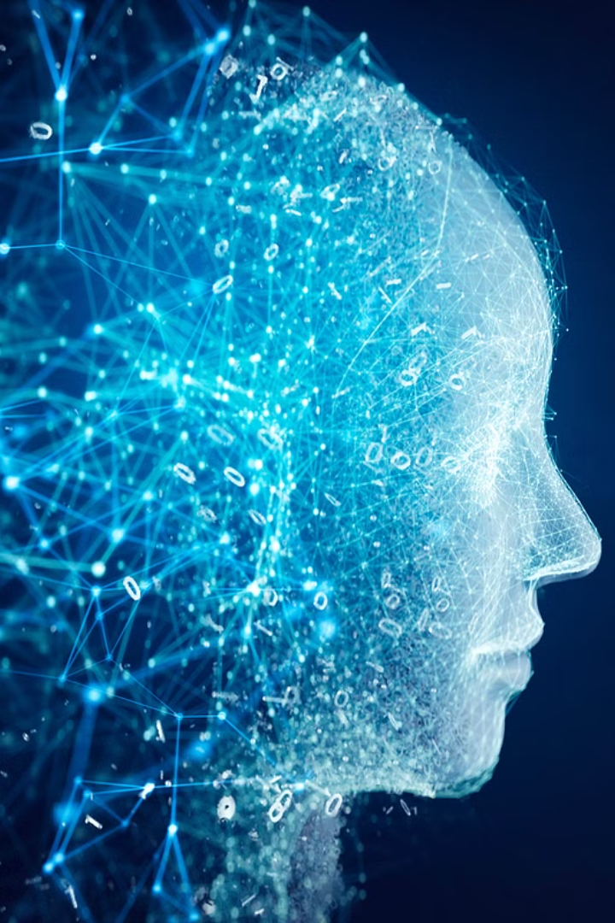


Introduction to AI
Artificial Intelligence (AI) is a branch of computer science that aims to create machines capable of intelligent behavior.
by Shivam Srivastava

Slide 2

Current state of AI technology
1
Rapid Advancements
2
Applications in Daily Life
3
Ethical Implications
AI has seen exponential growth in technology and capabilities in recent years.
AI is increasingly integrated into everyday devices and services.
Challenges arise in maintaining data privacy and security in AI systems.

Slide 3
Potential applications of AI in various industries
Healthcare
Finance
Transportation
AI can help in disease detection, personalized medicine, and patient care.
Applications include fraud detection, risk assessment, and algorithmic trading.
AI contributes to autonomous vehicles and traffic optimization systems.

Slide 4
Ethical considerations and challenges in AI development
Data Privacy
Human Bias
Job Displacement
Ensuring the responsible use and protection of personal information is crucial.
AI systems may reflect human biases, leading to unfair outcomes.
Risks associated with automation causing job loss and economic disruptions.

Slide 5
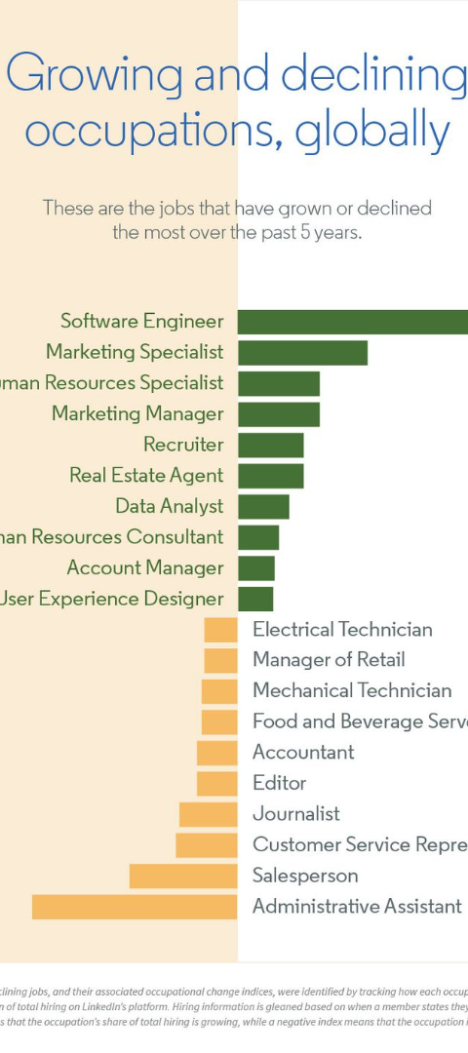



Impact of AI on the job market and workforce
Automation
Routine tasks are being automated, impacting certain job roles.
New Opportunities
AI creates new jobs in fields such as data science and AI engineering.
Skills Evolution
The workforce needs to adapt and develop new skill sets for the AI era.

Slide 6

Advancements in AI research and development
1
Deep Learning
Revolutionizing AI capabilities with advanced neural network models.
2
Natural Language Processing
AI systems understand and manipulate human language, enabling chatbots and text analysis.
3
Explainable AI
Focusing on making AI decision-making processes transparent and understandable.

Slide 7
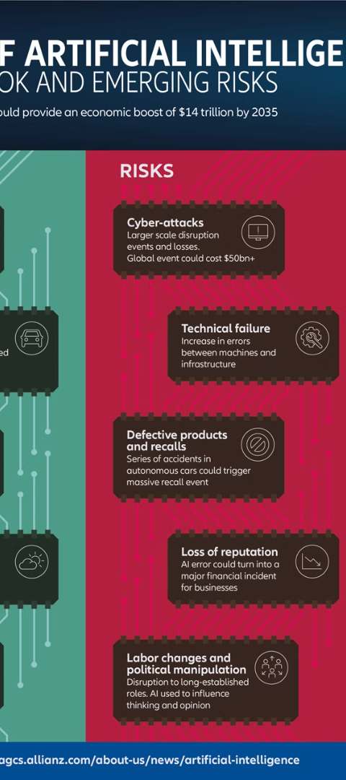
Future possibilities and potential risks of AI
1
Global Transformation
2
Ethical Concerns
AI has the potential to reshape industries and everyday life on a global scale.
Ensuring AI is used ethically and responsibly to prevent unintended consequences.
3
Regulatory Frameworks
The need for clear regulations and policies to govern the development and use of AI.

Slide 8
Conclusion and key takeaways
3
AI Ethics
Innovation
Collaboration
Ethical AI Design
Promoting Innovation
Importance of collaboration between technology experts, policymakers, and ethicists.
The consideration of ethics and societal impact in AI development is crucial.
Encouraging innovation while addressing the risks associated with AI technology.

Slide 9
